Slide 1
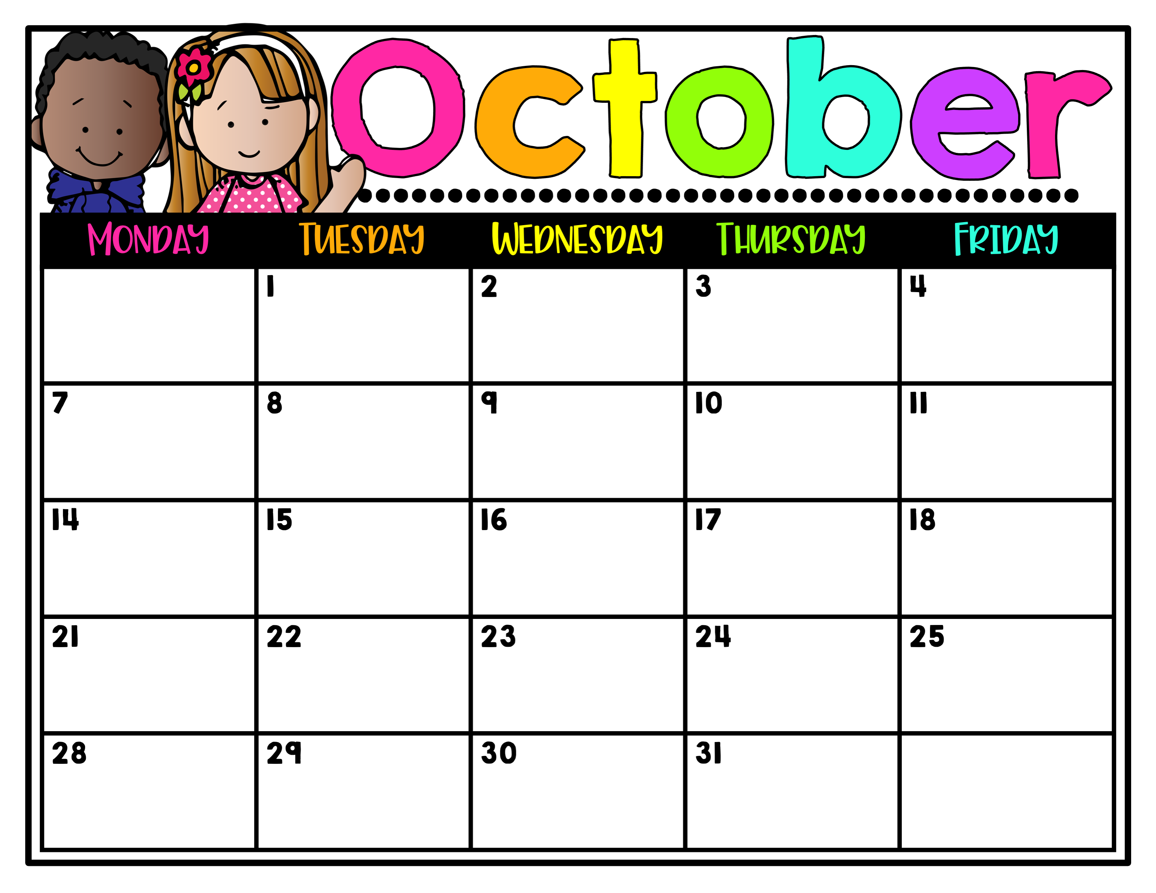
Day 3
Guidance
Day 4
Art
Day 5
P.E.
Fall Holiday
No School
Day 6
Library
Day 1
Music
Day 2
P.E.
Day 3 Guidance
TPD Community
Helpers Visit
Wear red shirt!
Day 4
Art
Day 5
P.E.
Day 6
Library
Day 1
Music
Day 2
P.E.
Day 3
Guidance
Day 4 Art
Wild Robot Trip
Wear red shirt!
Teacher
Planning Day
No School
Day 1 Music
BLITZ Begins
Wear red shirt!
Day 2
P.E.
Day 5
P.E.
Day 6
Library
Day 3
Guidance
Day 4
Art
Day 5
P.E.
Day 6
Library
Dress like a
Book Character
BLE
BLITZ
Wear red shirt!
Character Education Week

